Slide 1
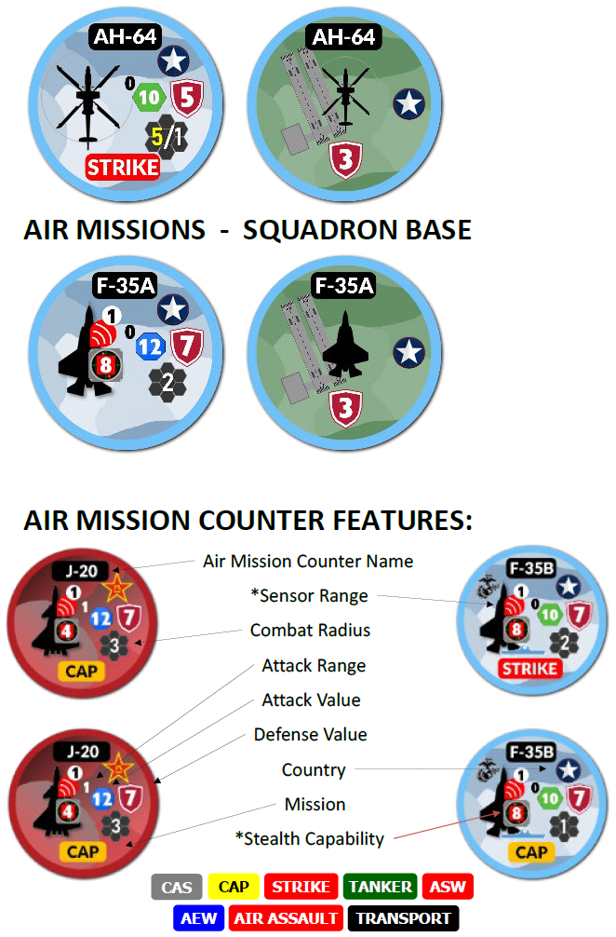


OWS Familiarization
DO NOT Distribute or proliferate any OWS materials beyond ACSC.
DO NOT upload OWS materials into any commercial AI products.
All OWS materials and images are restricted to official ACSC use and must not be shared outside current ACSC students and faculty.
8

Slide 2
There will be questions….lots of questions
Remember this is educational wargaming, not analytical wargaming.
The game piece abilities won’t be a direct representation of real capabilities.
Unclassified
Not all unit level tactics can be replicated with the game. Remember, this helps with “High Tactical” and Operational Planning.
Focus on sequencing, risk assessment, layering effects / effects-based planning.
Students and Faculty will resist the game and argue the rules.
Don’t be afraid to pause the game and have a discussion.
Lean on your student experts to explain tactics and planning considerations.
If game play devolves into rules disputes, intervene to offer a “logical conclusion”, document the question, and submit the question and conclusion to the WG team for review.
We are learning together.

Slide 3
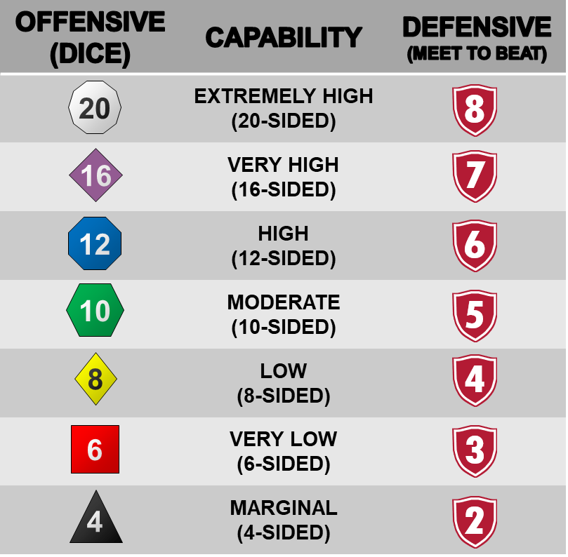
Probabilities based adjudication
When a modifier is applied to a capability die it ‘promotes’ or ‘demotes’ the die, increasing or decreasing the size of the die by one step, respectively. Promotion and demotion are often indicated on tokens by green ‘up’ and red ‘down’ arrows, respectively.
We won’t see the Red or Green arrows in the first tutorial, but we will discuss one demotion re: Striker Air Unit Self-Defense.
8

Slide 4
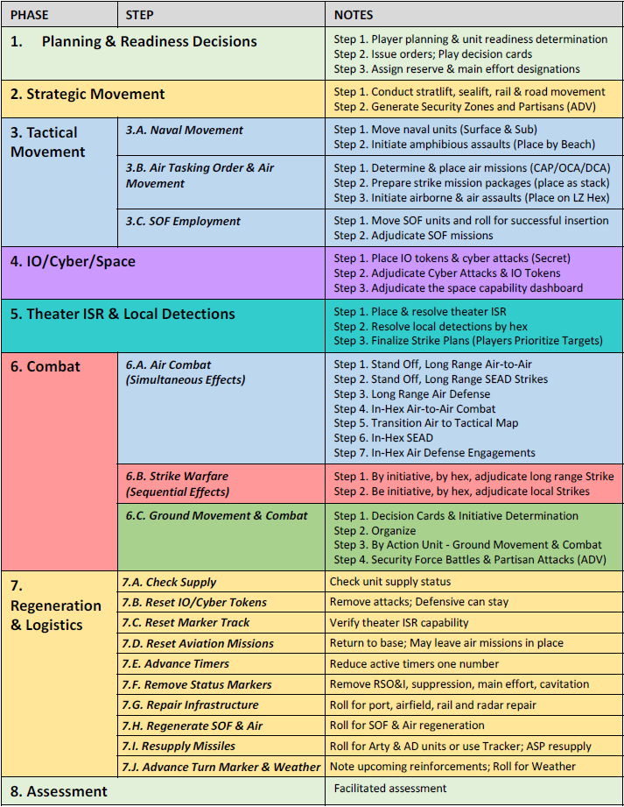
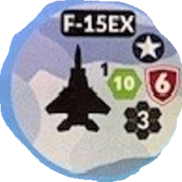
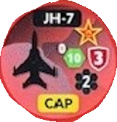
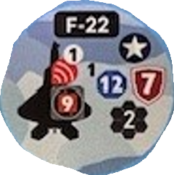
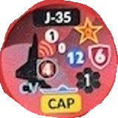
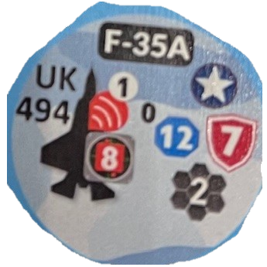
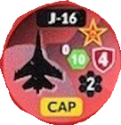
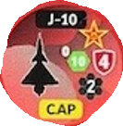
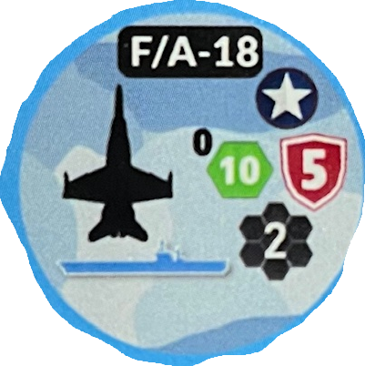
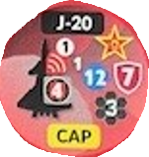
Air-to-air gameplay fundamentals (A2A)
Objectives:
Understand how to conduct the air war sequence in OWS, specifically focusing on:
Assigning and moving air missions (BLUE DCA v RED OCA)
Executing Local Detection of 5th Gen Fighter Aircraft (6.5.8.4, 8.3.3)
Execute Stand-off Long-Range A2A engagements
Execute In-Hex A2A engagements
By initiative, by hex, adjudicate local strikes
Notes for execution:
All Hexes are 200nm Hexes.
Blue and Red are contesting Air Superiority.
RED Strike Aircraft will be introduced in this tutorial.

Slide 5
Air-to-air gameplay fundamentals (A2A)
5th gen 4th Gen Match Up
6.5.7. Stealth Aircraft. Stealth aircraft are those with low radar signature and are depicted with a local detection indicator, such as the F-22, shown to the right, with its stealth / local detection value of 9. The highest detection die roll that can be made against a stealth aircraft is a d12. When operating in emissions control (EMCON), the counters are flipped to their “Unknown” side with the white silhouette. When in this mode, they can engage other aircraft in the same hex but cannot engage into an adjacent hex unless supported by another sensor that is actively emitting such as an E-3 or E-2D Airborne Early Warning (AEW) aircraft.
Example 1.
Prior to air combat in example 1, the J-16 is able to attempt Local Detection of the F-22. (The J-16, and all 4th Gen aircraft are assumed detected.)
Roll the J-16 attack value of 10 for local detection. If the J-16 rolls “8” or less the F-22 remains undetected.
8.5. Local Detections. Units on the map may attempt to detect other units with a Local Detection attempt. This represents visual or sensor detections (such as radars)…for low signature units, a detection roll is always required.
Example 2.
If J-16 rolls a 9 or higher, the F-22 is detected (flip piece over to indicate “detected”).
After local detection is resolved, proceed to Air Combat phase and execute In-Hex Air-to-Air combat.
Example 1. Only the F-22 may engage because it was NOT detected.
Example 2, both players engage because the F-22 was detected
1.
2.

Slide 6
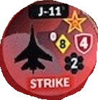
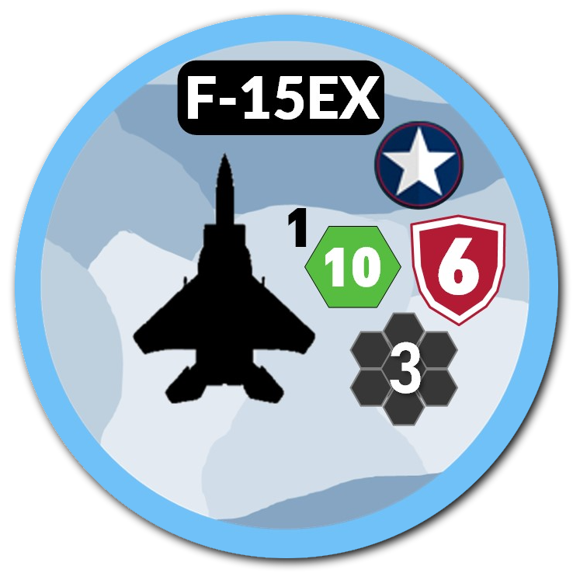
Air-to-air gameplay fundamentals (A2A)
4th Gen Match Up – Stand-off Long Range and In-Hex
In this example, the air movement phase is assumed completed.
No local detection is required because all aircraft are assumed detected (4th Gen)
Stand-off, Long Range A2A engagement
Only the F-15EX has an attack range of 1 and is the only aircraft in this example that can engage into an adjacent hex.
Roll attack value of “10” vs one of the J-16 defense value of “4”
Assess result
Proceed to In-Hex A2A combat
In-Hex A2A combat
Roll attack dice for remaining fighters prior to assessing results. Attacks occur simultaneously
F/A-18 can only engage one red air unit.
If J-16 survives Stand-off Long-Range engagement, it can still perform In-Hex Combat (2 v 1)
Assess rolled value compared to the defense value denoted by the number within the red shield icon.
If the roll is greater than or equal to the defensive value, the piece is removed and placed in the Regeneration Box.
If attack roll doubles the defense value, the piece is destroyed.
If each attack roll is less than the opponent's defensive value, the pieces remain in the contested space for the turn’s duration. Neither can complete additional engagements or advance.
(example: the F/A18 rolls a “9” and the J-16 rolls a “6”. The F/A-18 is moved to the regeneration box. The J-16 is removed from the game.)

Slide 7
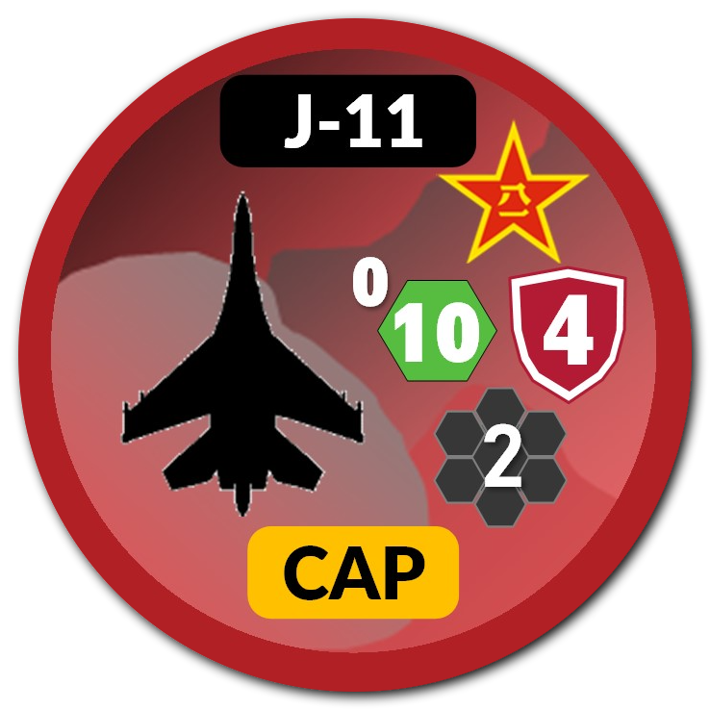
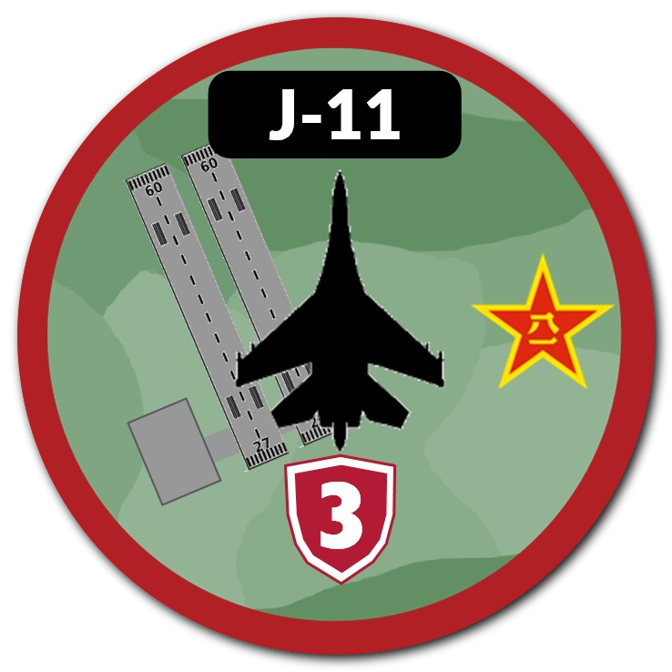
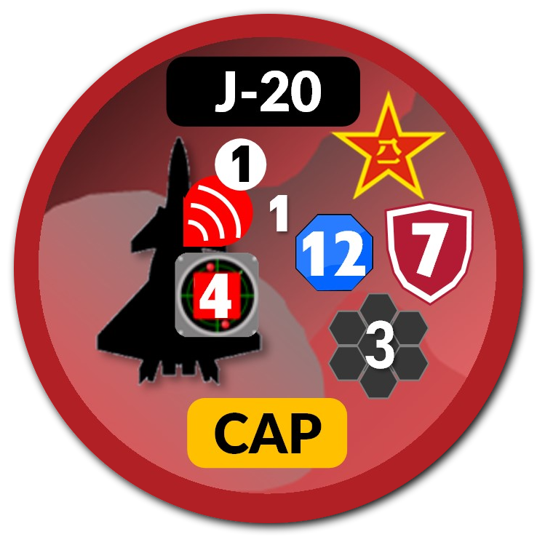
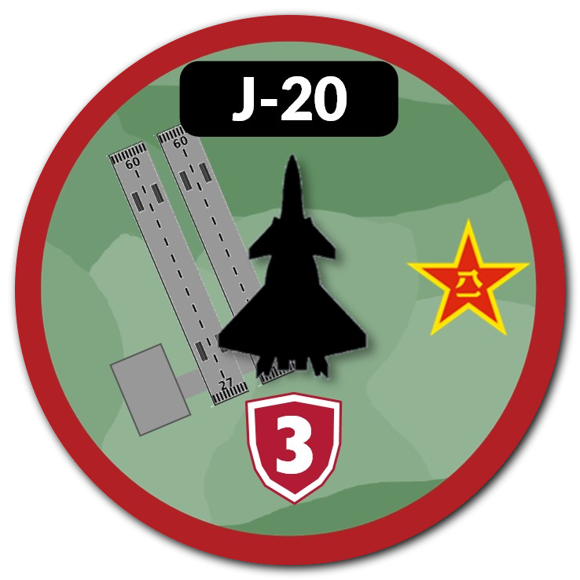
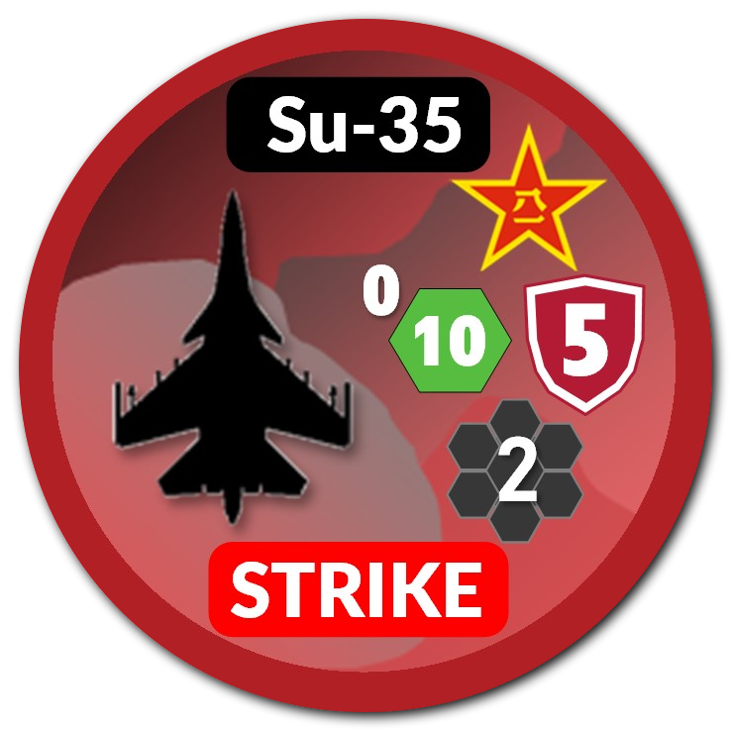
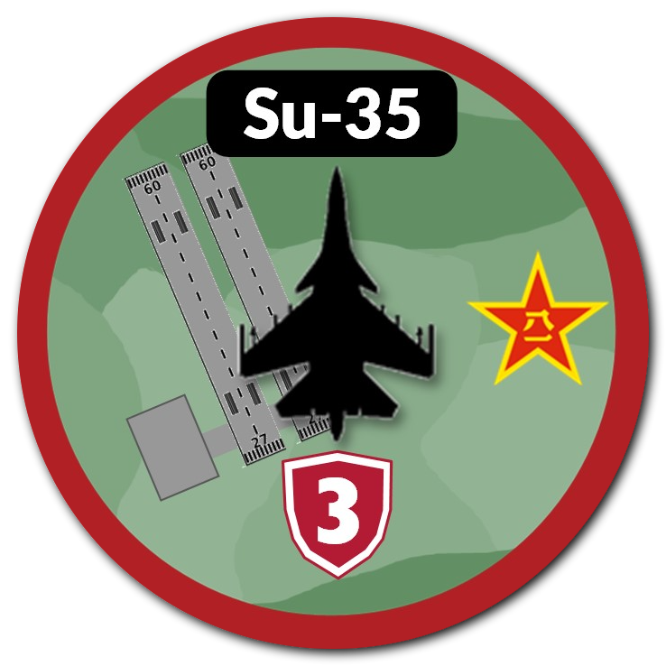
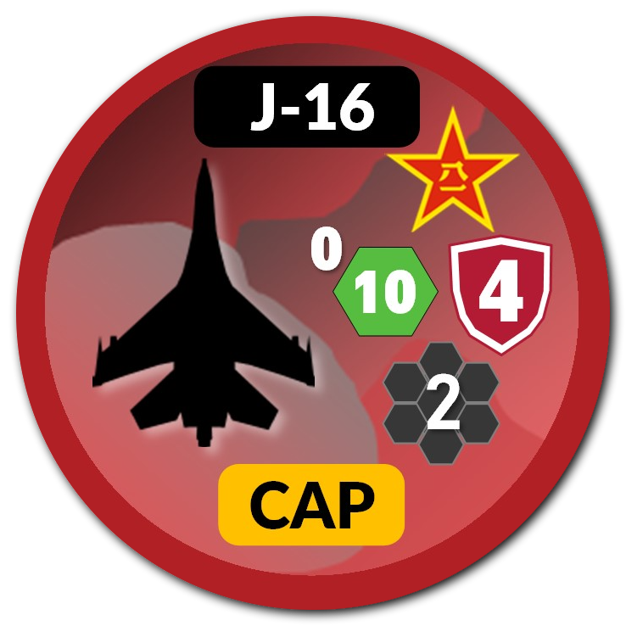
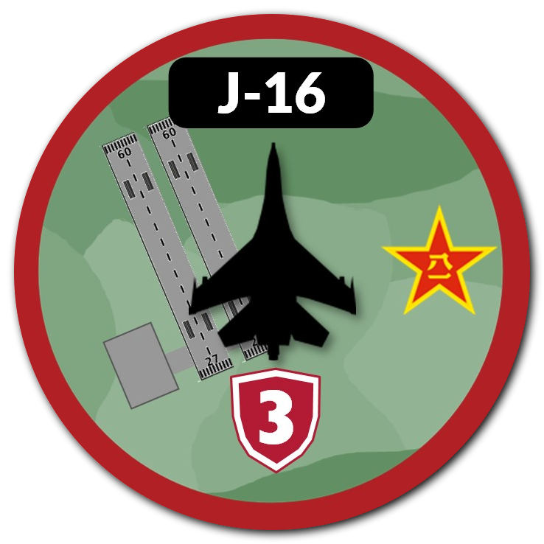
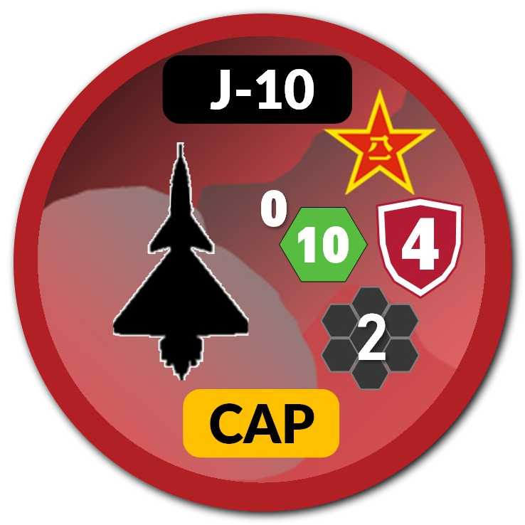
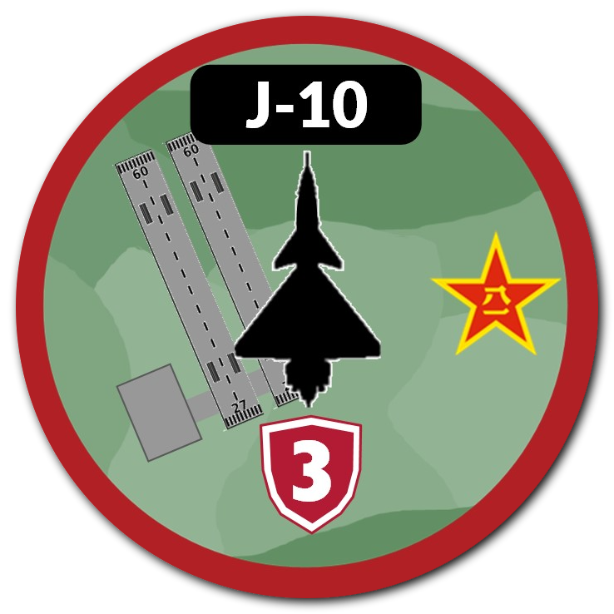
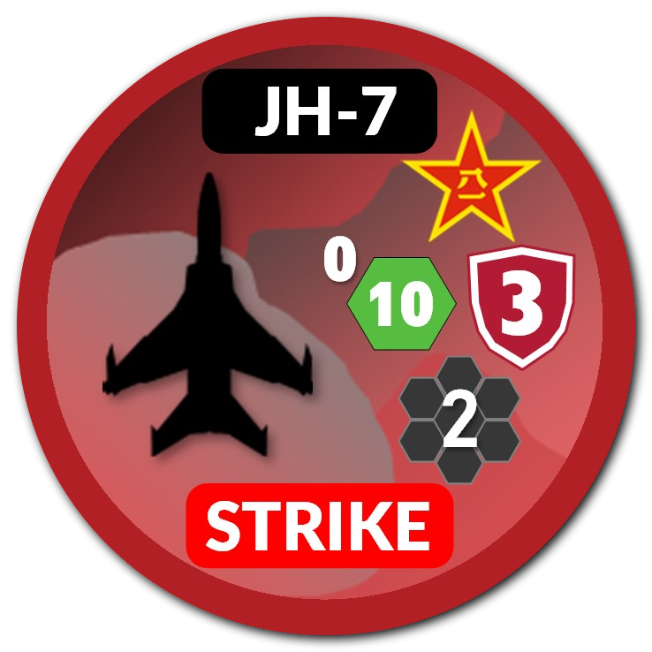
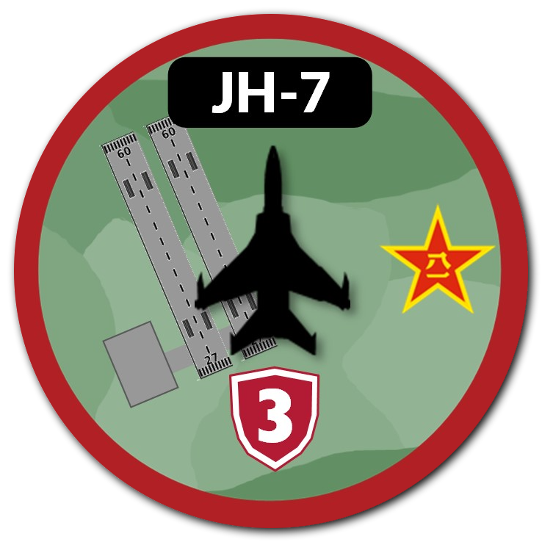
Air-to-air gameplay fundamentals (A2A)
5th gen 4th Gen Match Up – Add Stand Off, Long Range Air-to-Air Continued
6.5.7. Stealth Aircraft. Stealth aircraft are those with low radar signature and are depicted with a local detection indicator, such as the F-22, shown to the right, with its stealth / local detection value of 9. The highest detection die roll that can be made against a stealth aircraft is a d12. When operating in emissions control (EMCON), the counters are flipped to their “Unknown” side with the white silhouette. When in this mode, they can engage other aircraft in the same hex but cannot engage into an adjacent hex unless supported by another sensor that is actively emitting such as an E-3 or E-2D Airborne Early Warning (AEW) aircraft.
9.7.3 Step 1. Stand Off Air to Air. Resolve all long range (1 hex range) air to air missile engagements.
Example 1.
The F-22 elects to utilize a long-range engagement. Note the F-22 has an engagement range of “1” denoted next to its attack value. The J-16 is limited to in-hex engagement denoted by its attack range of “0”. This allows the F-22 to attempt the long-range engagement against the J-16.
NOTE: With no external or “off-board” sensing capability such as a E-2 or E-3, for the F-22 to engage into the adjacent hex, it sacrifices its low observability.
In this example there is no observed risk for the F-22 to conduct the stand-off, long-range engagement.
Example 2. Choose between engagement types
In this example, assume the F-22 is undetected after local detection attempt by the JH-7.
The F-22 now has the option to conduct either a long-range engagement against the J-16, in-Hex engagement against the JH-7, or both.
If the F-22 elects to conduct long-range engagement, it would then be assumed detected by the JH-7, which would then have an opportunity to engage the F-22 during the In-Hex Combat engagement.
Discussion: When might the F-22 elect to only choose the single in-hex engagement?
2.
1.

Slide 8
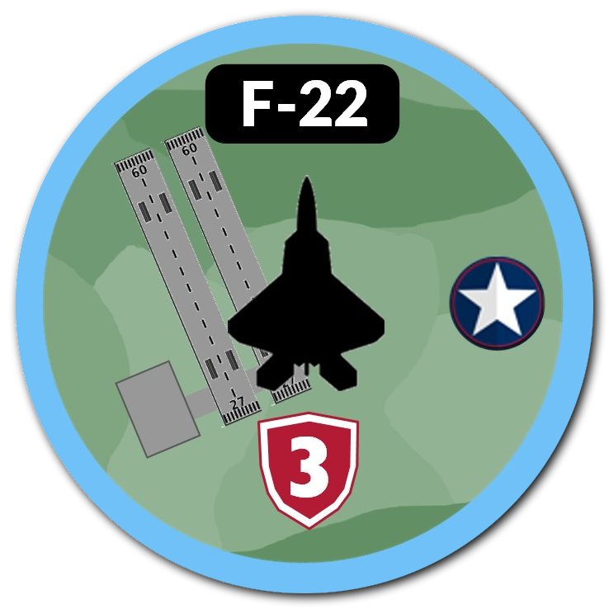
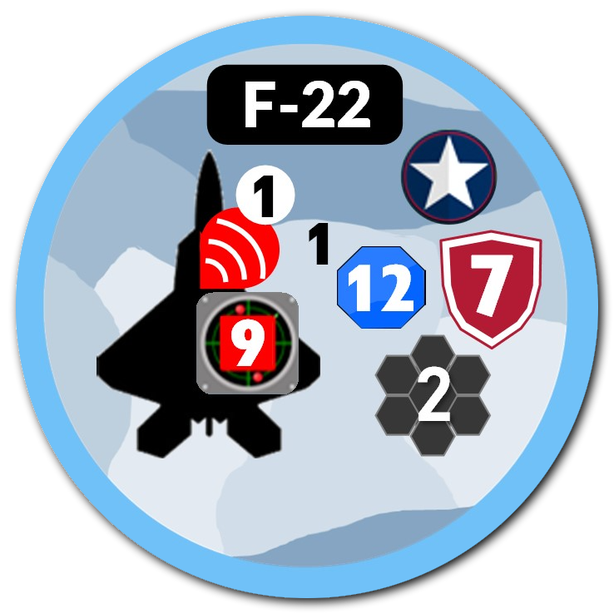
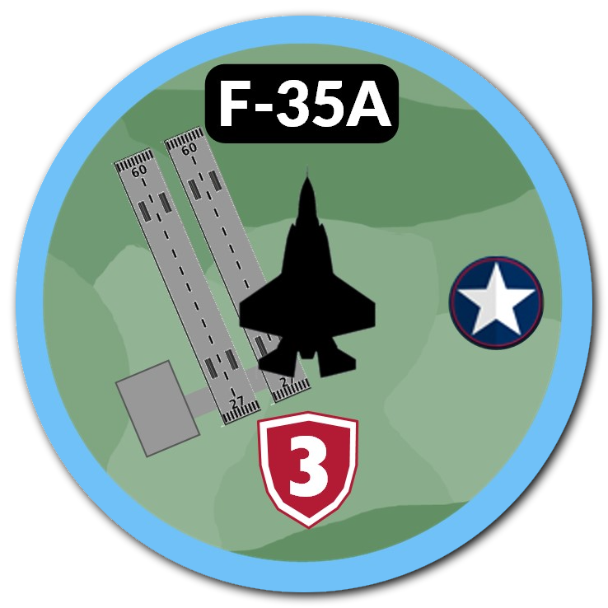
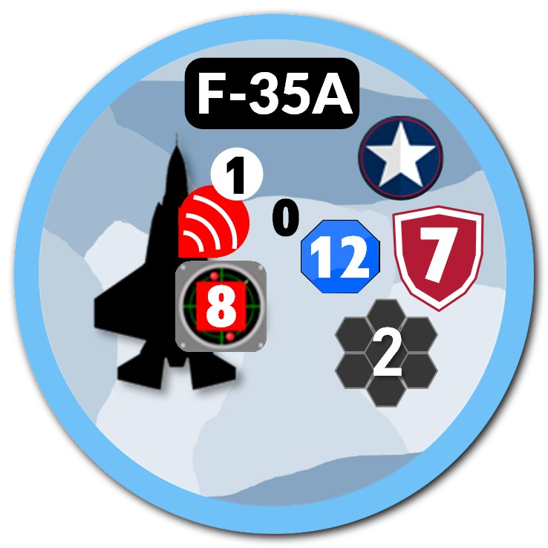
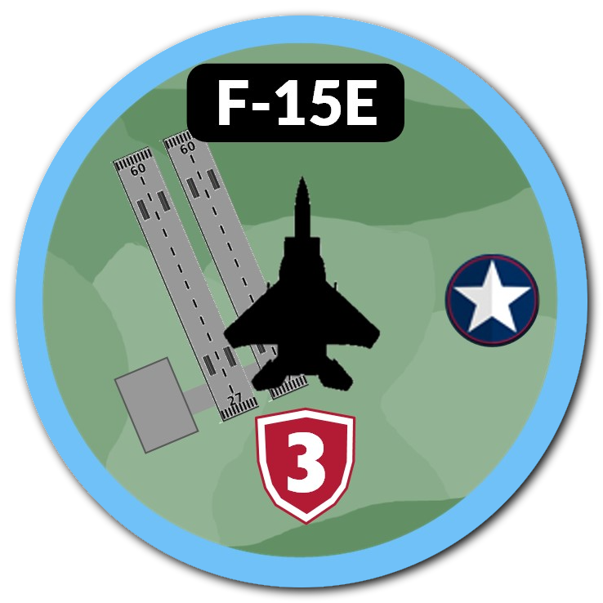
Air-to-air gameplay fundamentals (A2A)
5th gen vs multiple 4th Gen Match Up – Multiple Engagement Types
Intro to Defensive Counter Air (DCA) Risk and Engagement Priorities
Blue Mission Objective: Prevent Red Striker engagements on Blue Airfield.
6.5.7. Stealth Aircraft. Reference previously covered rule for Stealth Aircraft specifics.
Red has initiative:
Air Movement – Red declares movement to attack Blue air bases 2 hexes away.
Stand off, Long Range A2A: Blue F-22 may elect to contest one red air unit with long-range stand-off after Red declares their movement. (Build Slide)
NOTE: This is an exception and alteration to the gameplay sequence! This deviation is authorized so that one player can’t completely negate adversary capabilities due to initiative.
Blue F-22 pairs long-range stand-off against a J-11 Striker.
Student rolls a 12-side die. Assess results. (Build Slide)
Assume the F-22 is successful. The remaining 2 red air units proceed.
3. Resolve Local Detection: Roll attack value for both the J-10 and J-11 against the Unknown F-35. Assess Results and proceed to In-Hex Combat
If F-35 remains undetected, F-35 declares which red air unit to engage. Elects to engage remaining red J-11 Striker. WHY?
Red J-10 engage the F-22 because it became detected during its long-range engagement.
Assess In-Hex A2A engagements.
How might this have played out differently?
Were capabilities applied in the most advantageous way?
9
8

Slide 9
Air-to-air gameplay fundamentals (A2A)
5th gen vs multiple 4th Gen Match Up – Add Stand Off, Long Range Air-to-Air
Intro to Defensive Counter Air (DCA) Risk and Engagement Priorities
Blue Mission Objective: No Red Striker engagements on Blue Airfield.
6.5.7. Stealth Aircraft. Reference previously covered rule for Stealth Aircraft specifics.
Red has initiative:
Air Movement – Red declares movement to attack Blue air bases 2 hexes away with the strike package: 2 J-11 Strikers; 1 J-10 Escort.
Stand off, Long Range A2A (Deviation): Blue F-22 elects to not contest the air movement.
Resolve Local Detection: Roll attack value for both the J-10 and both J-11 against the F-22 and F-35. Assess results
Assume both F-22 and F-35 remain undetected.
Pair blue air units against red air units. (Which should be targeted?)
Have class conduct small break-outs to observe different outcomes with detection and engagement.
NOTE: 6.5.1.2. Air to Air Combat and Attack Missions. When a fighter in an “attack” mission (Strike, SEAD, CAS, Interdiction, SUCAP) is engaged in air-to-air combat, it uses a demoted die roll from its organic attack capability. It cannot initiate an air-to-air action but can defend itself if attacked.
- In the example shown, the J-11s are strikers. They can only engage in self-defense A2A engagements if they are attacked. When defending, their attack value is demoted from “8” to “6”. Against stealth aircraft, self-defense is only available if the stealth aircraft were previously detected.
HOWEVER….5th Gen remain Undetected, so no Striker Self-Defense is available.
9
8

Slide 10
Air-to-air gameplay fundamentals (A2A)
Intro to Defensive Counter Air (DCA) Risk and Engagement Priorities
Blue Mission Objective: No Red Striker engagements on Blue Airfield.
Red has initiative:
Air Movement – Red declares movement to attack Blue air bases 2 hexes away with the strike package: 2 J-11 Strikers; 1 J-10 Escort.
Stand off, Long Range A2A: N/A Blue F-22 elects to not contest the air movement.
Resolve Local Detection: Roll attack value for the J-10 and both J-11s against the F-22 and F-35.
Assume F-35 remains Undetected
Assume F-22 IS Detected
Red J-10 pairs against the F-22 for In-Hex A2A Combat, which means the F-22 MUST engage the J-10.
DCA aircraft must engage the OCA/ESCORT unit first. IF DETECTED!!
Any available interceptors are applied 1:1 versus escorting fighters. If interceptors exceed the number of escort fighters, then the excess fighters may directly engage the strike aircraft. Once fighter to fighter combat is resolved, if the interceptors overcome the fighter escorts, they may proceed to engage the strike aircraft. If the strike aircraft survives this detection and attack sequence, then movement to the launch container or In-Hex Strike continues.
If the J-10 survives the A2A engagement and remains In-Hex, then the F-22 unit is assumed to remained engaged and the Hex remains contested.
WHICH MEANS – THE F-22 IS UNABLE TO INTERCEPT THE REMAINING STRIKER
More fidelity on this rule in the next example.
9
8

Slide 11
Air-to-air gameplay fundamentals (A2A)
DCA Intro – Strike Phase Intro – RED Attacks Blue. Leads with 2 Red OCA/SWEEP
CAN DEFENDER FIRE TWICE?? Follow the game sequence to find out.
• Step 1: Initial Air Mission Allocation During the Air Tasking Order & Air Movement Phase (Phase 3.B.), a player allocates a fighter to an air superiority mission, such as a Combat Air Patrol (CAP), Offensive Counter Air (OCA), or Defensive Counter Air (DCA) mission. These fighters are designated to engage opposing air units.
1. Air Movement: Determine and place air missions (Build Slide)
2. Prepare Strike mission packages (Build Slide)
3. Stand-off Long-Range Deviation (N/A)
4. Resolve Local Detection
5. Stand-off Long-Range Engagements (N/A)
6. In-Hex A2A
****Assess Interceptor Posture/Availability*****
•Uncontested Airspace After surviving its initial air combat, the fighter must be in "uncontested airspace". This implies that any immediate, direct air threats that engaged it in the earlier air combat steps have been eliminated, forced to retreat, or otherwise are no longer presenting an immediate threat in that specific area (HEX).
Interception of a Strike Package Later in the Combat Phase, during the Strike Warfare Step (6.B.), an enemy player initiates an air strike against a ground target. As part of the "Air Strikes: Movement and Intercept Procedure":
◦ The enemy air units trace their route to their weapon launch point.
◦ The surviving fighter that was previously engaged and is now in uncontested airspace may be applied to intercept this strike package. This triggers its opportunity to engage twice in the same turn. BUT NEVER A THIRD TIME
◦ Interceptors (including this fighter) are first matched against any escorting fighters in a 1:1 ratio. If the interceptors outnumber the escorts, the excess interceptors can then directly engage the strike aircraft.
In essence, a fighter acts like a first responder in a dynamic environment. It first deals with an immediate aerial threat to secure the skies (initial air combat). If it successfully neutralizes that threat and remains operational, it can then be redeployed to intercept a new, separate threat, such as an incoming bombing run, giving it a second engagement opportunity within the same operational cycle.
8

Slide 12
Air-to-air gameplay fundamentals (A2A)
RED AIR ELIMINATED – ALL BLUE SURVIVE
ABORT OR CONTINUE?
RED AIR ELIMINATED EXAMPLE
8

Slide 13
Air-to-air gameplay fundamentals (A2A)
RED AIR ELIMINATED, F-15 EX Eliminated:
Abort or Continue?
RED AIR ELIMINATED EXAMPLE
8

Slide 14
Air-to-air gameplay fundamentals (A2A)
What if Single Red Unit Survives.
F-22 and F-15EX engaged.
Strike Package now has a 3:1 ratio against the unengaged F-35.
ABORT OR CONTINUE?
How many Blue DCA Air Units can engage the remaining Red Striker Units??
TWO. The F-15EX and F-35 are available because they exceed the number of remaining OCA Sweep units.
Can the Red Striker Defend itself against the Blue F-35?
- Yes, but only if the F-35 is detected?
Can the Red Striker defend itself against the Blue F-15EX?
- YES, but what restriction applies to Red’s attack value?
This demonstrates why it isn’t always beneficial to conduct detached SWEEP when a player could keep Escort attached.
Keeping Escort attached could benefit the attacker by increasing the opportunities to detect stealth aircraft and reduce the defender’s chances for secondary engagements.
Single Red Unit Survives
8

Slide 15
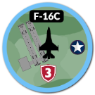
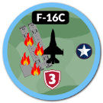
Adjudicate local strike (In-Hex)
What if one Red Striker Unit Survives?
Roll the striker attack value against the previously declared target’s defense value.
Assess Results.
Equal to or greater than equal to defense value = “step loss”
Airfields can be regenerated/repaired during the regeneration phase using a 6-side die.
Must roll a “1” to regenerate
8

Slide 16
Regeneration of Air Units
11.4 Reset Aviation Missions. Each player returns aviation missions to their airfields and aircraft carriers. Players may opt to leave aircraft in their mission assigned hex to expedite game play.
11.7 Regenerate Air Missions: Each Player rolls to regenerate the number of missions from the regeneration box. These die rolls are determined by special scenario rules.
For session 1, roll a 4-sided (black) die.
Example: Player rolls a “2”. Player chooses which 2 air units to regenerate.
Regeneration Box
8

Slide 17
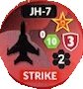
Air-to-air gameplay fundamentals (A2A)
5th gen vs multiple 4th Gen Match Up – Add Stand Off, Long Range Air-to-Air
Free Play: BLUE Defend ZULU Base
Experiment with different Blue force composition. Remember to
Note: In this block of training, never exceed numerical overmatch by more than 1 or 2 pieces by either side. Game mechanics, employment techniques, and capabilities observations are the desired learning objectives.
KEEP DIGGING INTO THE RULES FOR CLARITY. UPCHANNEL QUESTIONS.
TRY NOT TO MAKE THIS TUTORIAL TOO COMPLICATED. PRACTICE THE GAME SEQUENCE
ZULU BASE
Max 3 Air Units
F/A-18
F/A-18
YANKEE BASE
Max 3 Air Units

Slide 18
